Slide 1

Basic Data Statistics and Exploratory Data Analysis (EDA)

Slide 2
Basic Data Statistics

Slide 3
Mean, Median, Mode
The mean is the average of all the values in the data set. To calculate the mean in Python, we can use the mean() function from the NumPy library.
The median is the middle value in the data set when the values are arranged in order. To calculate the median in Python, we can use the median() function from the NumPy library.
The mode is the value that occurs most frequently in the data set. To calculate the mode in Python, we can use the bincount() function and argmax() from the NumPy library.

Slide 4
Standard deviation and variance
The standard deviation is the square root of the variance. To calculate the standard deviation in Python, we can use the std() function from the NumPy library.
The variance is the average of the squared differences from the mean. To calculate the variance in Python, we can use the var() function from the NumPy library.

Slide 5
Exploratory Data Analysis (EDA)

Slide 6
Introduction
Exploratory Data Analysis (EDA) is a crucial step in the data analysis process. It helps to summarize the main characteristics of a dataset and to uncover patterns and relationships. In this presentation, we will provide an overview of the EDA process and highlight its importance in making data-driven decisions.

Slide 7
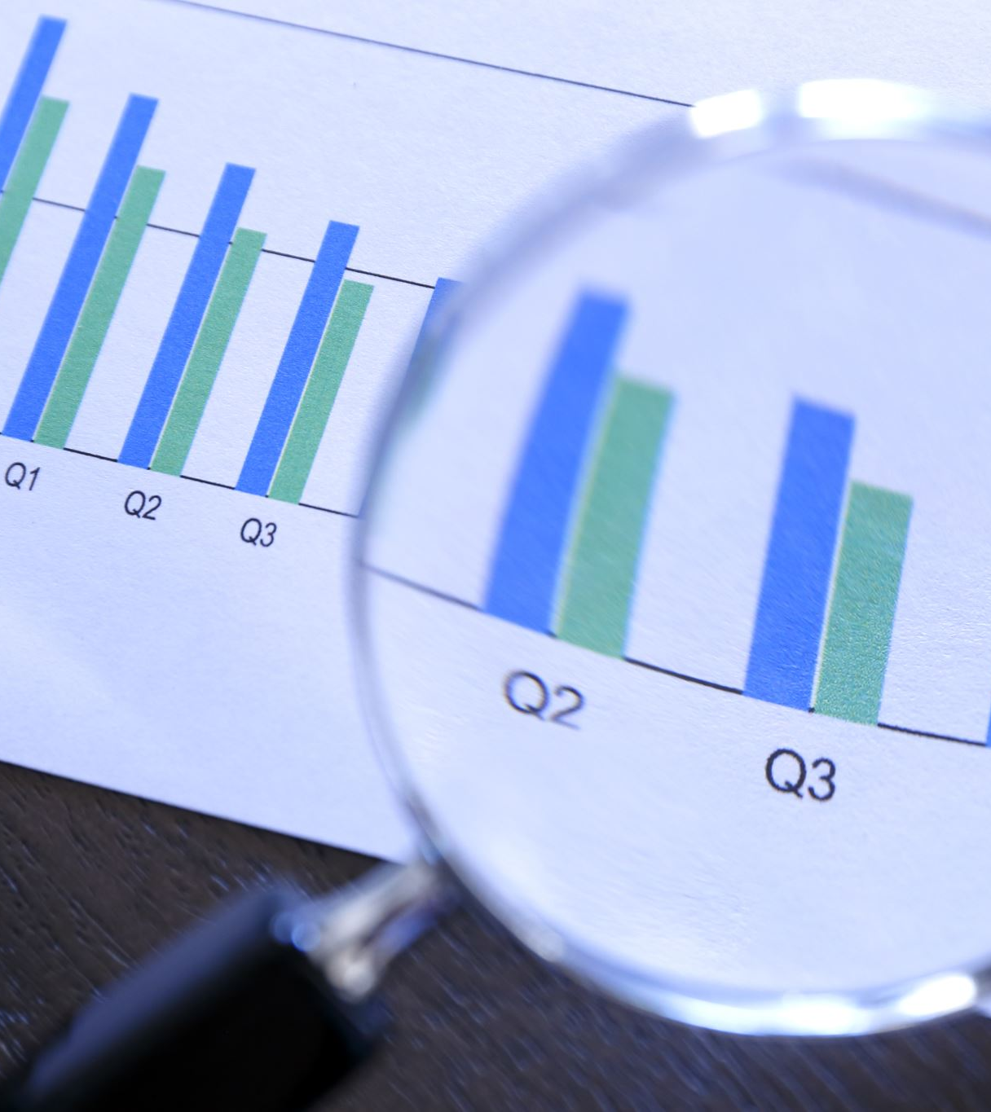
Data cleaning
Before starting the EDA process, it is important to ensure that the dataset is clean and free of errors. This includes removing duplicates, dealing with missing values, and addressing outliers. Data cleaning is a critical step that can significantly impact the accuracy of the analysis.

Slide 8

Data visualization
Visualizing data is an effective way to gain insights and communicate findings. Data visualization can be used to explore patterns and relationships, identify outliers, and highlight trends. In this section, we will discuss different types of visualizations and their applications.

Slide 9

Descriptive statistics
Descriptive statistics provide a summary of the main characteristics of a dataset. This includes measures of central tendency, such as mean and median, and measures of variability, such as standard deviation and range. Descriptive statistics can be used to identify patterns and outliers in the data.

Slide 10

Correlation analysis
Correlation analysis is used to measure the strength and direction of the relationship between two variables. This analysis can be used to identify potential predictors or to understand the impact of one variable on another. In this section, we will discuss different types of correlation and their applications.

Slide 11
Conclusion
EDA is a critical step in the data analysis process that can provide valuable insights and inform decision-making. By cleaning the data, visualizing the patterns, calculating descriptive statistics, and analyzing correlations, we can better understand the data and make informed decisions. Thank you for joining us in this comprehensive guide to EDA.

